Slide 1
Pronunciation
æ vs ɛ

Slide 2
http://www.youtube.com/watch?v=y5czC8HBEfo

Slide 3
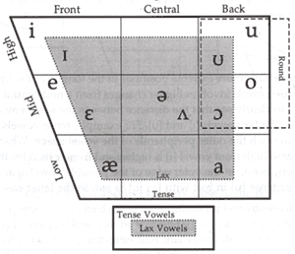
American English Vowels

Slide 4
Front Vowel Practice
Vowel | Example word
i | meat
I | mitt
e | mate
ɛ | met
æ | mat

Slide 5
http://www.uiowa.edu/~acadtech/phonetics/#

