Slide 1
SLA in the HEAD
Professor. Joan Kelly Hall / APLNG 491
Yohan Hwang
Margarita Seregina
Alyson O’Shea
Juhyun Park
Notes:
Today we, margarita, alyson, jenny will talk out SLA in the HEAD
We have been working on this project since I picked up the first on the lottery. At the very first beginning it was hard to organize three sessions, but we became a profession about this topic. so welcome to the world of SLA in the HEAD. let me get started.

Slide 2
Principle of SLA
Linguistic
Psychological
Social
Notes:
As a matter of fact, there are many principles of second language acquisition, which can be divided into three categories one can be Psychological principle Another one is social principle related to sociology. The other is linguistic, which focus on language itself However, each perspectives are somehow related to each other so sla should be taken into consideration in terms of like psycholinguisitcs and social psychology, sociolinguistics something like we had learned the first day of class.

Slide 3
SLA in the HEAD
Psycho-
logical
Psycho-
linguistics
Input
Interlanguage
Fossilization
Brain
Krashen
Two case studies
Noticing
Negotiation of Meaning
Go ANGEL
Interaction
Notes:
So, our first group have been working on how psychological or psycholinguistics aspects work when learning and acquiring second language. and how make it more effective when it comes to SLA. First of all, I will discuss how linguistic input will take place in the head based on Krashen Input hypothesis and then how has it taken up in the field of 1980's how other people get notion from krashen’s theory like why people taking about krashens notion of comprehensible and i will make you guys aware of what are people talking about what are the things they are they are starting to look at. [ENTER]And margarita will explains two key terms related to sla such as interlanguage asserted by elinker and fossilization which has a negative influence on sla. [ENTER]Alyson and jenny will talk about interaction hypothesis, which have a positive impact of sla. [ENTER]And we are gonna talk about two research studies for next two sections, based on the notion that what kind of research questions the other researchers have. we posted one of case study on the ANGEL. In sum, Four piece of puzzles will be presented through tree sections to create a big picture of SLA in the HEAD from 1960s to 1970s. Shall we start?

Slide 4
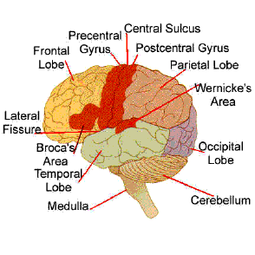
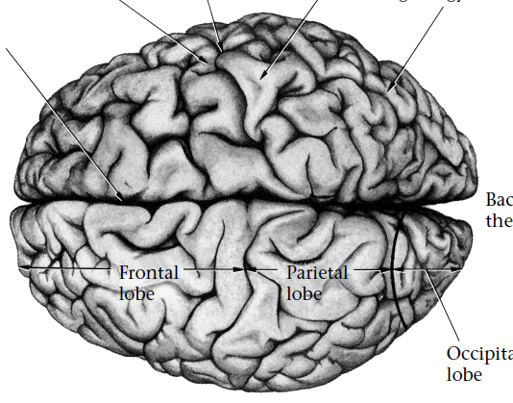
How the brain processes language
Notes:
First of all, we need to take a look at how brains work when it comes to acquisition of language in order to understand how the learner acquires a second language and where sla takes places. The human brain displays a number of phycological and structural characteristics. The process in which language is development into the brain is very complex as you can see on this picture of brain. But I don’t want to go all the way to research each part of brain today like FRONTAL LOBE WERNICK’S AREA because I cannot even read it. But I want to talk little bit about which part of brain is related to language process.

Slide 5
How the brain processes language
Left Hemisphere: there is some specialization for language in the left hemisphere and in certain areas of the left hemisphere
Language acquisition and performance, especially syntax
Krashen, Stephen D. Second Language Acquisition and Second Language Learning. Prentice-Hall International, 1988.
Notes:
Structure of brain can be explained in two parts. One is right hemisphere and the other one is left hemisphere. Language skills are localized in the cortex of the left hemisphere. This information retrieved from krashens second language acquistion and second language learning. So if you dont understand second language or you are in trouble in learning second language, what do you need to do? Knock the left side of your head. You are supposed to laugh at this point.

Slide 6
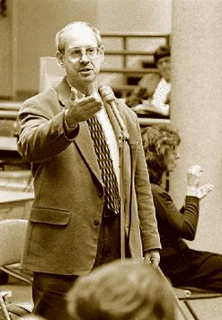
Stephen Krashen(00-00)
“we acquire language when we understand messages,
when we understand what people tell us,
when we understand what we read”
Notes:
Well anyway, then now, I will explain how the left hemispher acquires a second language I mean, how second language acquistion takes place in the head. To create a output, what do we need first? Yeah Input. Language acqusition starts with an input. We acquire language when we understand when we understand what people tell us, when we understand what we read.
There have been many studies which one could be good input on
1960s and 1970s. It starts from who? YEAH Stephen Krashen (University of Southern California) is an expert in the field of linguistics, specializing in theories of language acquisition and development. Much of his recent research has involved the study of non-English and bilingual language acquisition.
During the past 20 years, he has published well over 100 books and articles and has been invited to deliver over 300 lectures at universities throughout the United States and Canada.This is a brief description of Krashen's widely known and well accepted theory of second language acquisition, which has had a large impact in all areas of second language research and teaching since the 1980s.

Slide 7
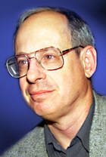
1960s-1970s
Input Hypothesis
Hi, I am Dr. Krashen “Language acquisition does not require extensive use of conscious grammatical rules, and does not require tedious drill”
Notes:
Ok let have a quick review of his monitor theory, what is it? Based on his theory, he arrested that Language acquisition does not require extensive use of consicos grmmatical rules, and does not requrie tedious drill.
Because Input hypothesis is only concerned with 'acquisition', not 'learning'. According to this hypothesis, the learner improves and progresses along the 'natural order' when he/she receives second language 'input' that is one step beyond his/her current stage of linguistic competence.
There are tons of different kinds of input in language acquistion. Then, we need to make distincition between good and bad input, because knocking the left side of your head can not be a good input at all.
and if I speak Korean right now, how many of you can understand? So keep saying korean cannot be an good imput even though I spent tons of time Let me say input is like rubber ball. Linguistic input or comprehensive input is kind of like me thrawing a rubber at you. Like this is the linguistic input, 쉭 can you get it? No, I need to threw futher in order to make ron react to the ball. So in order to make sure you can get a ball, I need to say ok this is a baseball I am going to threw away right now, are you ready instead of just thrawing ninety thousand different color ball. This is what Krashen indicate on his Comprehensive Input. If I threw a buch of baseball, we need to make sure students mightneed to push back themselves little bit futher to catch only one of them.

Slide 8

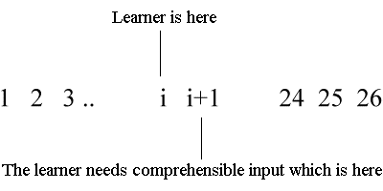
The Comprehensible Input
Notes:
Based on this concept, Stephen Krashen devised a notion for the kind of input that an ESL student needs in order to make progress in acquiring English. [ENTER] This equation represents a ESL student’s learning. The input or I stands for what the student is learning and the +1 stands for challenging a students one level ahead of his or her current level of proficiency. Clearly, an ESL student cannot cope with or learn from language input that is at i+24 or i+25. The input must be made comprehensible. Indeed, Krashen states that comprehensible input is a sufficient condition for language acquisition.
For example, if a learner is at a stage 'i', then acquisition takes place when he/she is exposed to 'Comprehensible Input' that belongs to level 'i + 1'. Since not all of the learners can be at the same level of linguistic competence at the same time, Krashen suggests that natural communicative input is the key to designing a syllabus, ensuring in this way that each learner will receive some 'i + 1' input that is appropriate for his/her current stage of linguistic competence.

Slide 9
Criticism of Comprehensible Input
What is I?
Can we Change I?
What is good I?

Slide 10
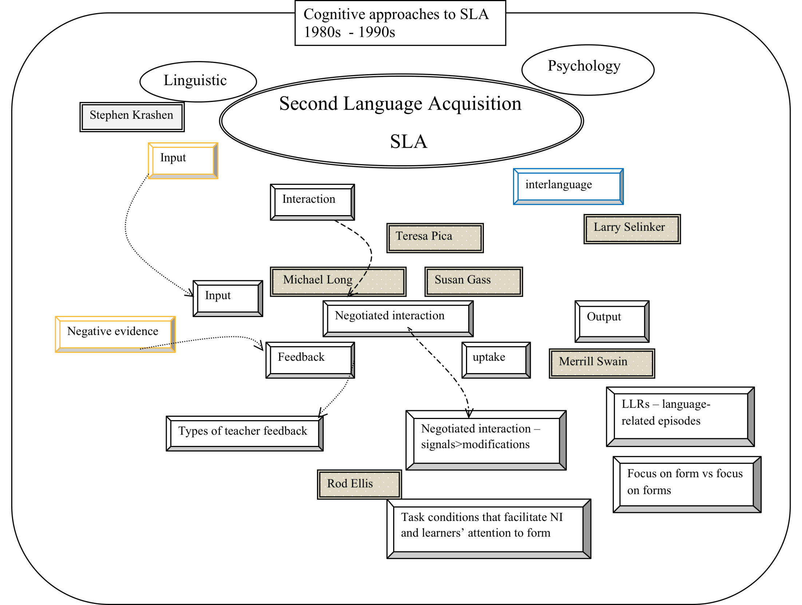

Slide 11
1960s – 1970s
Stephen Krashen
Teresa Pica
Michael Long
Susan Gass

Slide 12
Margarita

Slide 13
Interlanguage and Fossilization
Interlanguage (IL) is an emerging linguistic system that has been developed by a learner of L2 who has not become fully proficient yet but is approximating the TL.
The rules used by a learner on a particular stage of his development are not found in either his mother tongue or the TL.

Slide 14
The origin of the term IL
The term was coined by Larry Selinker in 1972. However, S. Pit Corder is considered to be responsible for raising problems which became central to studies of IL.
IL is based on the theory that there is a “psychological structure latent in the brain” which is activated when a person tries to learn L2.

Slide 15
Learning strategies of creating IL
Language transfer – the learner uses his mother tongue L1 as a resource for language learning:
Positive transfer;
Negative transfer;
Avoidance;
Overuse;
Overgeneralization (at the phonetic, grammatical, lexical levels and at the level of discourse);
Simplification.

Slide 16
IL in context
Variations of IL. Various aspects of SLA occur differentially within discourse domains (“internally created contexts, within which IL structures are created differentially”). (Selinker and Doughlas)
Interlanguage Pragmatics – acquisition and use of L2 pragmatic knowledge; deals with how people use language within a social context. (Bardovi-Harlig, Kasper and Schmidt)

Slide 17

Fossilization
The term was borrowed from paleontology. It refers to earlier language forms that become encased in a learner’s IL and cannot be changed by practice of the TL.

Slide 18
Fossilization
Interlanguage fossilization is a stage during a language learning process, when a permanent cessation of progress towards the TL comes.
Fossilization includes “linguistic items, rules and subsystems which speakers of a particular NL will tend to keep in their IL” (Selinker)
The concept of fossilization is considered to be one of fundamental phenomena of SLA.

Slide 19
Alyson and Jenny

Slide 20
[T]he importance of interaction is not simply that is creates learning opportunities, it is that it constitutes learning itself.
Dick Allwright, 1984: 9
Notes:
20

Slide 21

Alison Mackey
Ph.D. in Linguisticts at University of Sydney (1995)
M.Phill in Linguistics at University of Cambridge (1989)
B.A. in Englsih, Linguistics & law at Lancaster University (1988)
Georgetown University
Interaction approach

Slide 22

Michael Long
Originally from England
A professor of SLA at the University of Maryland
Focus on form – focusing students’ attention on linguistic forms in a meaning-based lesson
Interaction Hypothesis – 1980s, modified in 1996
Notes:
A
22

Slide 23

Teresa Pica
The School District of Philadelphia
The Pennsylvania Dept. of Education
The TESOL Workshop program
Areas of Expertise:
  SLA
  Language curriculum design
  Approaches to classroom practice
  Classroom discourse analysis
Notes:
23

Slide 24

Susan Gass
At the Michigan State University
  The Director of the English Language Center
  Co-director of the Center for Language Education and research
  Director of the Second Language Studies Ph. D. Program
President of the International Association of Applied Linguistics
Notes:
24

Slide 25

Merrill Swain
Professor in the Curriculum, Teaching and Learning department at the University of Toronto
Bilingual education, CLT
“The Output Hypothesis: A Search for Empirical Evidence in a Classroom Second Language Acquisition Context” (1992)
Notes:
A
25

Slide 26
Interaction Hypothesis
Expanding on the nativists’ emphasis on input only
  Based on Krashen’s (1981) theory of comprehensible input
Vygotsky the social-interactionist
Involves:
  Receiving comprehensible input and interactional feedback (Gass, 1997; Long, 1996; Pica 1994b)
  Being pushed to make changes in output (Swain, 1995, 2005)
  Negotiating meaning (Gass, 2003)
  “notice the gap” (Schmidt & Frota, 1986)
Notes:
26

Slide 27
Interaction Hypothesis (Cont.)
Interaction facilitates the process of SLA
The linguistic modifications that take place in interaction provide language learners with necessary input
When language learners do not understand or are not understood by their conversational partners (communication breakdown), they must participate in negotiation for meaning
Notes:
A
27

Slide 28
Negotiation for Meaning
http://www.youtube.com/watch?v=OjAGANuA9qE
Modification of interaction in order to repair communication impasses and reach mutual understanding (Ritchie, & Bhatia, 2009, p. 678)
Repair, clarification requests, comprehension checks, confirmation checks, recasts
The interaction may lead the learner to notice a gap between their production and that of their interlocutor
Notes:
A
28

Slide 29
Noticing
“Cognitive process through which learners compare their interlanguage version of form with a version in the input and notice the difference between them” (Ritchie, & Bhatia, 2009, p. 678)
Noticing leads the learner to become aware of their own incorrect production, and what the correct version may be
Once they have noticed this gap, learners take this information and produce comprehensible output

Slide 30
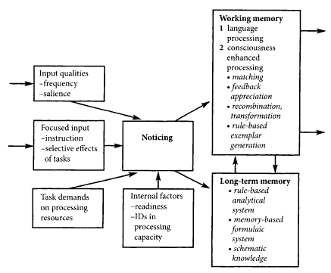
Output
Input
Notes:
Reference needed
30

Slide 31
Output
1980s and 1990s
When a learner produces an incorrect utterance:
  Negotiate for meaning
  Produce the correct version
  Acquire the correct form
Comprehensible output can aid in the acquisition of correct forms (Swain, 1993)
Notes:
A:
When a learner produces an incorrect (ungrammatical, incomprehensible, etc.) utterance, must negotiate for meaning, then finally produce the correct version, this leads the learner to acquiring the correct form.
Thus, comprehensible output can aid in the acquisition of correct forms.
that in order for learners to increase their L2 proficiency they need to produce language by speech or writing and to receive feedback on the comprehensibility of their output
Swain (1985) states that in order for learners to increase their second language proficiency they need to produce language via speech or writing and to receive feedback on comprehensibility of their ouput
Points that comprehensible input is a necessary but not sufficient condition for SLA based on long term L2 immersion programs in Canada (swain 1991) found that NNS did as well as NS on measures of receptive skills, but significantly poorer on measures of productive skills
Swain (1993) suggests four ways in which output might aid SLA that input alone could not
Promoting fluency by meaningful language use
Pushing learners to engae in syntactic processing oflangauge
Allowing hypothesis testing as to what works in the L2 interms of appropriacy, correction and understandiability
Providing opportunities for feedback from others in such forms as negotiating meaning or supplying missing words
Group works are better; dictogloss which groups of students work together to reconstruct a text their teacher has read to them. It is effective for encouraging student-studet interaction from
31

Slide 32
Output (Cont.)
Swain (1993) suggested four ways in which output might aid SLA:
  Meaningful language use
  Pushing learners to engage
  Allowing hypothesis testing
  Providing opportunities for feedback from others
Notes:
32

Slide 33
Research Questions
How important are interaction and output in the acquisition of a second language?
Does noticing aid in the acquisition of a second language?
What types of negotiation for meaning are most effective in leading toward acquisition?
Notes:
A
33

Slide 34
Testing the Interaction Hypothesis
Varonis and Gass (1985) reported more negotiation of meaning in dyads composed of two nonnative speakers than when a NNS and a NS were paired
Rulon and McCreary (1986:182) reported groups promote negotiation of meaning
Gass, Mackey, and Ross-Feldman (2005) suggested that interaction may be more task-dependent
Notes:
34

Slide 35
Importance of Noticing and Negotiation
Schmidt & Frota (1986) recorded Schmidt’s negotiation and noticing of Portuguese
Altman (1990) recorded her own noticing of Hebrew verbs
Truscott (1998) suggests that noticing is helpful in the acquisition of metalinguistic knowledge, but not necessary in SLA
Notes:
A
35

Slide 36
Problems of the Comprehensible Output (CO) Hypothesis
Krashen (1998)
  Scarcity of output
  Acquisition can occur without output
  CO does not necessarily lead to acquisition
  Affective filter associated with CO

Slide 37
References
Altman, R. (1990). Accounting for successful vocabulary development through learner introspection. Paper presented at the AILA Ninth World Conference of Applied Linguistics, Thessaloniki, Greece, April, 1990.
Cross, J. (2002). ‘Noticing' in SLA: Is it a valid concept?. TESL-EJ, 6(3), Retrieved from http://writing.berkeley.edu/TESL-EJ/ej23/a2.html
Krashen, S. (1998). Comprehensible output?. System: An International Journal of Educational Technology and Applied Linguistics, 26(2), Retrieved from http://www.sdkrashen.com/articles/comprehensible_output/all.html Truscott, J. (1998). Noticing in second language acquisition: A critical review. SLA Research 14, 103-135.
Ritchie, W., & Bhatia, T. (2009). The New handbook of second language acquisition. Bingley, UK: Emerald Group Publishing.
Schmidt, R., & Frota, S. (1986). Developing basic conversational ability in a second language. A case study of an adult learner of Portuguese. In R. Day (Ed.), Talking to learn: Conversation in second language acquisition, (pp. 237-326) Rowley, MA: Newbury House.
Long, M, (1996). The role of the linguistic environment in second language cquition. In. W.C. Ritchie & T.K. Bhatia (Eds.), Handbook of second language acquisition (pp. 451-2). San Diego, CA: Academic Press.

Slide 38
References
Varonis, E., & Gass, S. M. (1985). Non-native/non-native conversations: A model for negotiation of meaning. Applied Linguistics, 6, 71-90.
Gass, S., Mackey, A., & Ross-Feldman, L. (2005). Task-based interactions in classroom and laboratory settings. Language Learning, 55, 575-611.
Gass, S. M. (1997). Input, interaction, and the second language learner. Mahwah, NJ: Erlbaum.
Gass, S. M. (2003). Input and interaction. In C. Doughty & M. H. Long (Eds.), The handbook of second language acquisition (pp. 224–255).Oxford, UK: Blackwell.
Pica, T. (1994b). Research on negotiation: What does it reveal about secondlanguage learning conditions, processes, and outcomes? LanguageLearning, 44, 493–527.
Swain, M. (2005). The output hypothesis: Theory and research. In E. Hinkel (Ed.), Handbook of research in second language teaching and learning (pp. 471–483). Mahwah, NJ: Erlbaum.
Allwright, D. 1984a "Why Don't Learners Learn What Teachers Teach? - The Interaction Hypothesis." In Singleton and Little (eds): Language

